Slide 1

Rockbuster Stealth
Strategic Data Analysis:
Evolving into Online Streaming Services
Scott Ellis
1/11/2022

Slide 2
Business Areas of Concern:
Data Overview
Movie Catalog Composition
Total Revenue Gain by Movie Type
Geographic Distribution of Customers and Revenue
Revenue by Region
Categories by Region
Recommendations/ Next Steps
Why?:
We must have a solid understanding of our current business model if we are to successfully move into online video streaming services.
Bottom Line Up Front:
Invest in categories, regions, and other movie metrics that show the most opportunity, while investigating underperforming areas.

Slide 3
1. Data Overview
Green tables were used in this analysis.
Film Actor
Actor
Inventory
Film
Language
Film Category
Category
Payment
Rental
Customer
Staff
Store
Address
City
Country

Slide 4
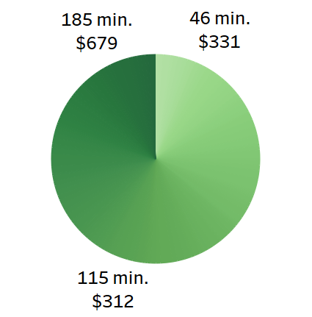

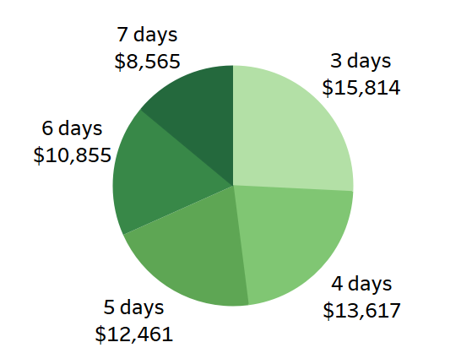
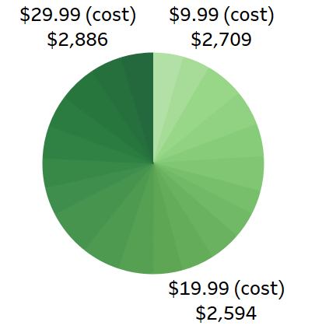
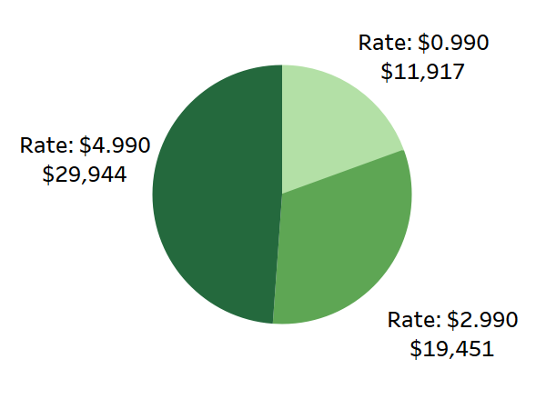
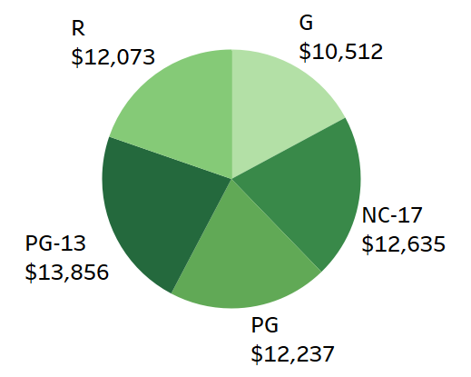
2. Movie Catalog Composition
Rental Duration of 3 days and Rental Rate of $4.99 contribute disproportionally to revenue gain.
Total Movie Count: 1,000
*Chart dollar amount is revenue per category
Release Year:
Minimum: 2006
Maximum: 2006
Average: 2006
Rental Duration (days):
Minimum: 3
Maximum: 7
Average: 5
Rental Rate ($):
Minimum: 0.99
Maximum: 4.99
Average: 2.98
Length (minutes):
Minimum: 46
Maximum: 185
Average: 115
Replacement Cost ($):
Minimum: 9.99
Maximum: 29.99
Average: 19.99
Rating:
Mode: PG-13

Slide 5
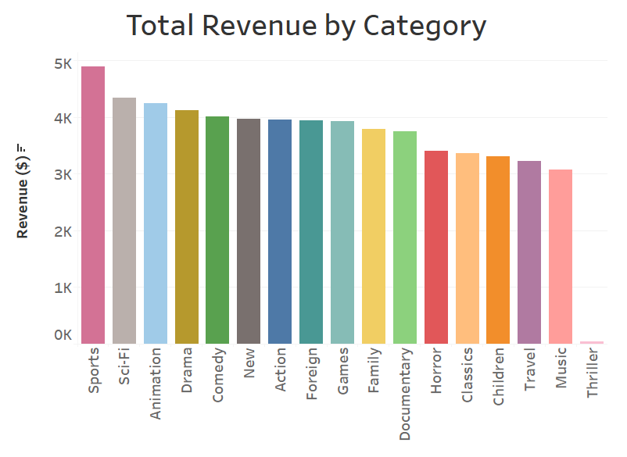
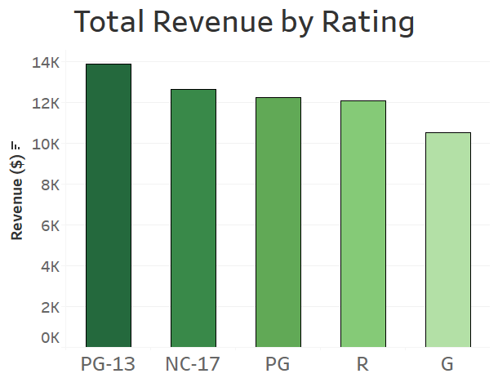
3. Total Revenue Gain by Movie Type
Global revenue breakdowns show that Sports and PG-13 movies make the most, while Thriller and G-rated movies make the least.

Slide 6
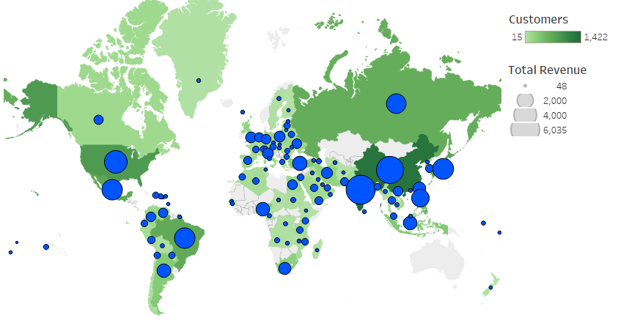
4. Geographic Distribution of Customers and Revenue
Cities of Top 5 Customers (by lifetime payments):
1. Ambattur, India
$111.76
2. Shanwei, China
$109.71
3. Iwaki, Japan
$106.77
4. Acua, Mexico
$100.77
5. Aurora, U.S.
$98.76

Slide 7
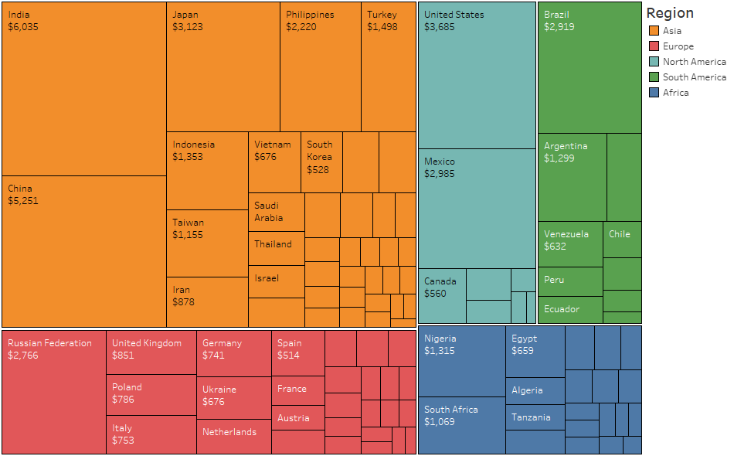
5. Revenue by Region
Asia
Europe
North America
South America
Africa

Slide 8
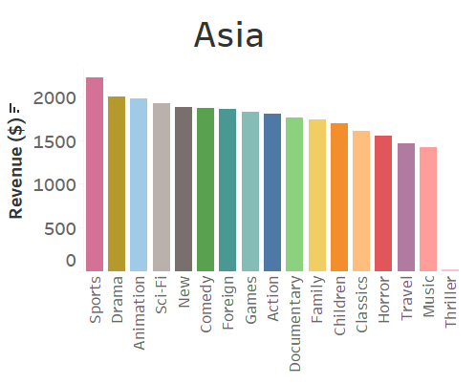
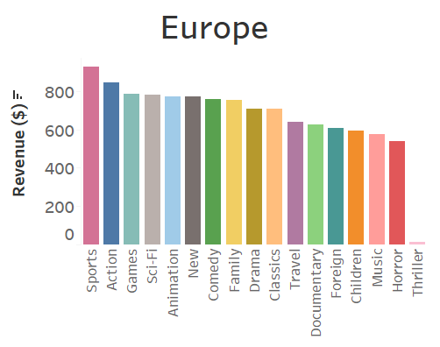
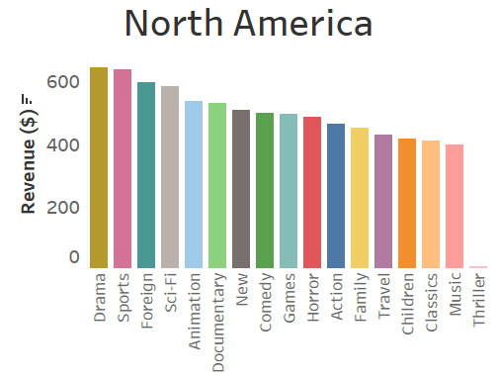
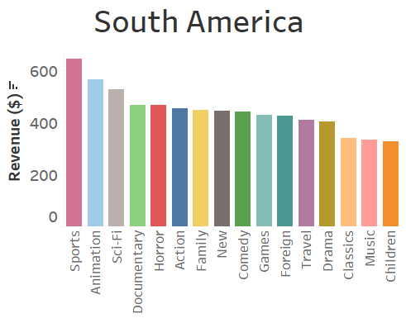
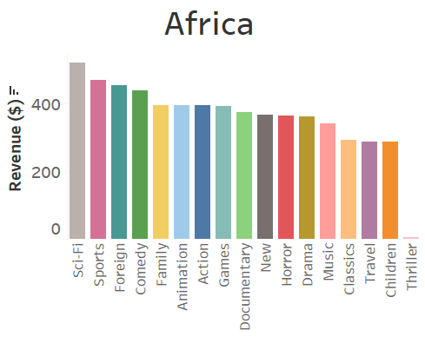
6. Categories by Region
Revenue by category varies significantly between regions.
Some categories perform well across regions (Sports, Sci-Fi, Animation).

Slide 9
7. Recommendations/ Next Steps
Next Steps:
Investigate poor performing types of movies (Thriller, G-rated) for further insights
Gather data on customer satisfaction in order to analyze unmet needs
Recommendations:
Focus on Regions
Each region should have a unique online streaming catalog, mirroring the category breakdown by revenue
Invest in money-makers
Movies with Rental Duration of 3 days and Rental Rate of $4.99 should receive additional funding for marketing and sales

Slide 10
Questions?
Contact Scott at scottellisanalyst@gmail.com
Tableau link: https://public.tableau.com/app/profile/scott.ellis1807/viz/Rockbuster_16416872789260/3_CountriesPaymentmap?publish=yes

